Slide 1
Infant Mortality PredictionUsing Pakistan Demographic and Health Survey (2017-2018)
MUHAMMAD UZAIR ASLAM
18097

Slide 2
PROBLEM STATEMENT
To predict infant mortality from Pakistan Demographic and Household Survey (2017,2018).

Slide 3
DATA SETS
Data Source : The DHS Program Demographic and Health Surveys
Initially data contained 50,500 sample points and 1186 features
The class variable for predicting mortality presented in data is: “Child is alive”

Slide 4
METHODOLOGY:
The Pakistan: Standard DHS, 2017-18 was divided in two parts.
I used a threshold of (80-20) where 80% of the data was used to train models and 20% of the data was for testing of those models.
I took small steps to clean, analyze and model this data.
I used the following Classifiers:
Neural Networks ( 3 layers densely connected using Keras )
Random Forest
Support Vector Machines
Gaussian Naïve Bayes
Logistic Regression
Light Gradient Boosting Machine

Slide 5
Data Uploading and Extracting Infants Sample points
Extracted the Infants sample points
This reduced the sample points from 50,500 to 2486 with 1186 features
a highly imbalanced distribution (1:19) ratio of child not surviving to surviving

Slide 6
PREPROCESSING
Among the 1,185 features only 97 features were numeric.
Dummy encoding for nominal and ranking the categorical features
There were around 104,000 null values in the data which were imputed.
Correction of Data types and extensive data wrangling and cleaning.
I dropped 886 features using criteria:
Random generated numbers like Case ID, Country code etc
More than 60% of null values.
That leaked information or had redundant information.
That required extensive feature engineering such as Date columns.
After preprocessing data was reduced to 489 features without losing significant information.

Slide 7

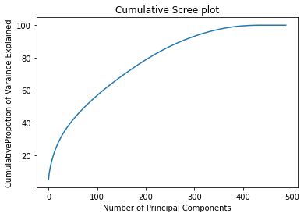
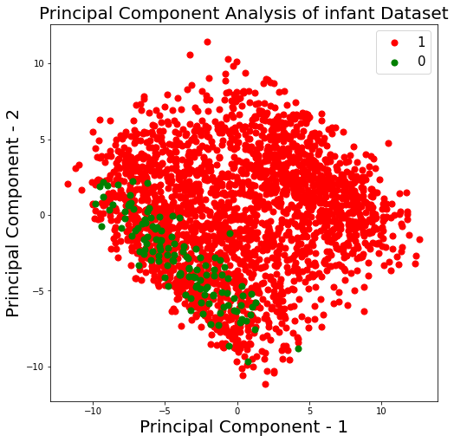
Dimensionality Reduction
Used PCA to capture the 95% variance which reduced the dimensionality to 321 features.

Slide 8
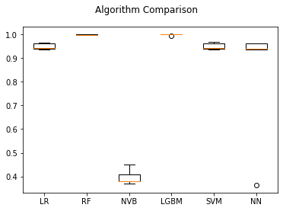
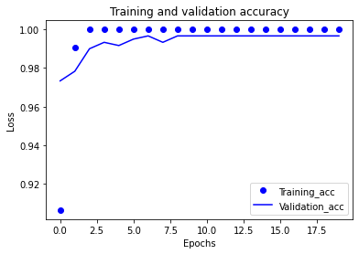
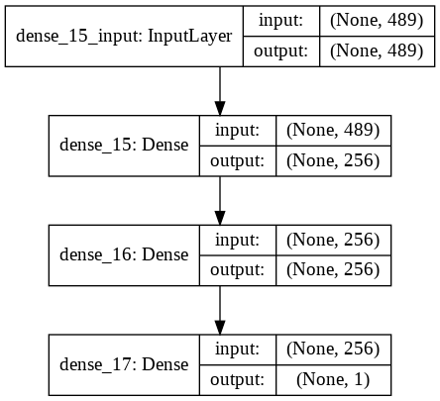
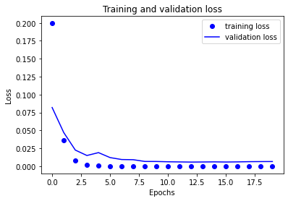
TRAINING
Figure 1 shows Comparison of Algorithms on 5 Cross Validations
Figure 2 and 3 shows training/validation accuracies and losses of Neural Networks
Figure 4 demonstrates the full network topology of Neural Networks.

Slide 9
RESULTS AND DISCUSSION Results reported on Full Features
Metric | Neural Networks | Logistic Regression (reduced by PCA) | Support Vector Machine | Random Forest | Light Gradient Boosting Machine | Naïve Bayes
AUC | 0.996 | 0.976 | 0.943 | 0.958 | 0.979 | 0.799
Precision | 1.000 | 0.954 | 0.941 | 1.000 | 1.000 | 0.621
Recall | 0.862 | 0.954 | 0.889 | 0.917 | 0.958 | 0.621
F1 | 0.926 | 0.954 | 0.914 | 0.957 | 0.979 | 0.621
Accuracy | 0.992 | 0.996 | 0.994 | 0.996 | 0.998 | 0.956

Slide 10
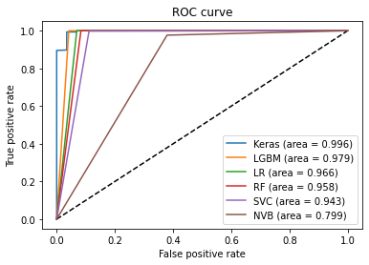
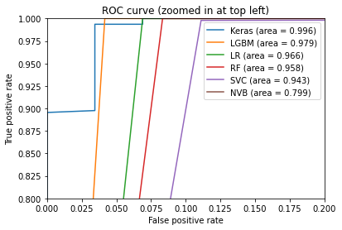
ROC Curves
Figure 1 shows the full plot of ROC curves with their scores.
Figure 2 shows the curves zoomed in from top left to get a better idea of the classifiers performance.
The Classifier with the best ROC curve is LGBM.

Slide 11
These results are reported on 10 best Features. The features were reduced by Simple Sequential Forward Selection (SSFS) from package Mlxtend and using Feature Importance.
Metric | Light Gradient Boosting Machine | Random Forest
AUC | 0.979 | 0.500
Precision | 1.000 | 0
Recall | 0.958 | 0
F1 | 0.979 | 0
Accuracy | 0.998 | 0.994

Slide 12
Findings for feature importance: Table:3 Feature Importance by LGBM and Random Forest
Table 3: Feature importance by LGBM and Random Forest
LGBM feature importance | Random Forest feature importance
Women's individual sample weight (6 decimals) | Currently breastfeeding
Currently breastfeeding | Child's weight in kilograms (1 decimal)
Child's weight in kilograms (1 decimal) | Months of breastfeeding
Wealth index factor score combined (5 decimals) | Living children + current pregnancy
Wealth index factor score for urban/rural (5 decimal place) | Sons who have died
Received POLIO 1 | Birth weight in kilograms (3 decimals) of Child
Marriage to first birth interval (months) | Duration of breastfeeding
All woman factor - wealth index | Received POLIO 0
Preceding birth interval (months) | Child's age in months
Child's height in centimeters (1 decimal) | Daughters who have died

Slide 13
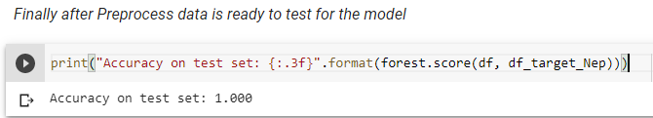
Final Test and Model Deployment
The model was tested on Demographic and Health Survey Nepal(2016).There were 378 samples.
The model at the back end was Random Forest which took 10 parameters based on feature importance.
It gave 100% accuracy on the test data set.
Finally the model is deployed on Heroku using Flask app.
Link: https://infantmortalityapi.herokuapp.com/

Slide 14
Conclusion and Future Work
In this study, I tried to solve the problem of infant mortality which is very critical for developing economies such as Pakistan
This is a novel idea as previous works have used health cards to predict infant mortality but this is the first time that classification models were built on demographic and health survey data sets.
Future work in this field focus on extending my study to:
more general features such as maternal factors
household distribution of income is to be connected to the infant mortality predictions.
Conditions of living in rural areas with infant mortality.
Link of Poverty and Infant Mortality Predictions

Slide 15
References
Ghahfarokhi, S. G., Jamil Sadeghifar, & Mosayeb Mozafari. (2018). A model to predict low birth weight infants and affecting factors using data mining. J Bas Res Med Sci , 5(3):1-8.
Santos, A. B., & Deborah Ribeiro Carvalho. (2018). PREDICTIVE MODELS FOR INFANT MORTALITY IN THE STATE OF PARANÁ. Iberoamerican Journal of Applied Computing .
Saravanou, A., Clemens , N., Nicholas , H., Dolores , A.-G., & Dimitrios , G. (2019). Infant Mortality Prediction using Birth Certificate Data.

Slide 16
THANK YOU!

